Slide 1
Industrial Project Final meeting Build your own digital 3D clone using Augmented Reality
Students – Amit weil & Elon Grubman
IBM supervisors – Yochay Tzur, Adi Raz goldfarb

Slide 2
Main Goal and methodology
Goal
Creating a 3D model based on ArKit scans, apply it on different scans.
Methodology
Volumetric scanning - integrate features into grid.
ray casting - scan along features ray
create mesh using marching cubes

Slide 3
Project timeline & Milestones we’ve achieved so far
Week 1 - Setting up the working environment, installing OpenCV, getting a better understanding of the project objectives
Parse ARkit into our classes, creating a basic design for the project.
Week 2 + 3 - Understand how to load & display images with OpenCV, implementing projection of 3D point into a 2D image, verifying the correctness of our code by checking the point position from different frames.
Week 4 -Implementing a 3D grid containing voxels.
Week 5 + 6 -Ray casting with ARkit features and frame’s camera’s positions, using bresenham’s algorithm to mark voxels accordingly.
Week 7 -Add confidence and distance field to each voxel and update them according to the number of rays touching the voxel.
Verifying correctness of the code, presenting the ray casting output on the 3D grid and presenting the grid in all of the frames.

Slide 4
Project timeline contd
Week 8 - Creating an heat map of the grid according to the confidence values
Week 9 + 10 - integration of our program with marching cube algorithim in order to create mesh from our grid, starting from a circle example.
Densify the given ARkit data and create a thicker less sparse 3D model
create ply files for camera positions, features, grid borders, grid
w.s.t confidence.
Week 11 - adjusting our code in order to receive a better looking model, create multiple meshes with different parameters to see the difference in the results.
Measuring our running time, make run time optimizations, eventually converging into the desired running time.

Slide 5
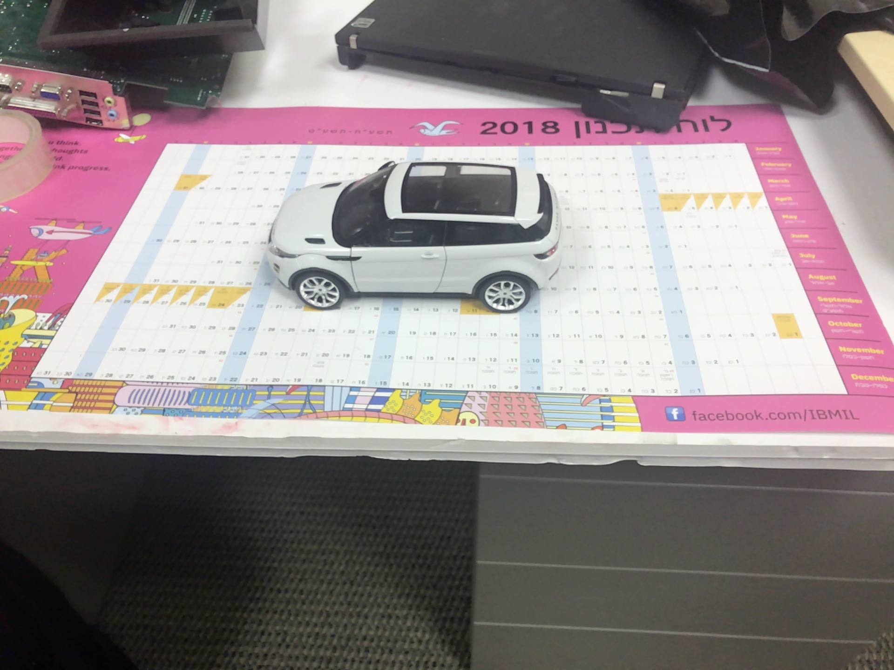
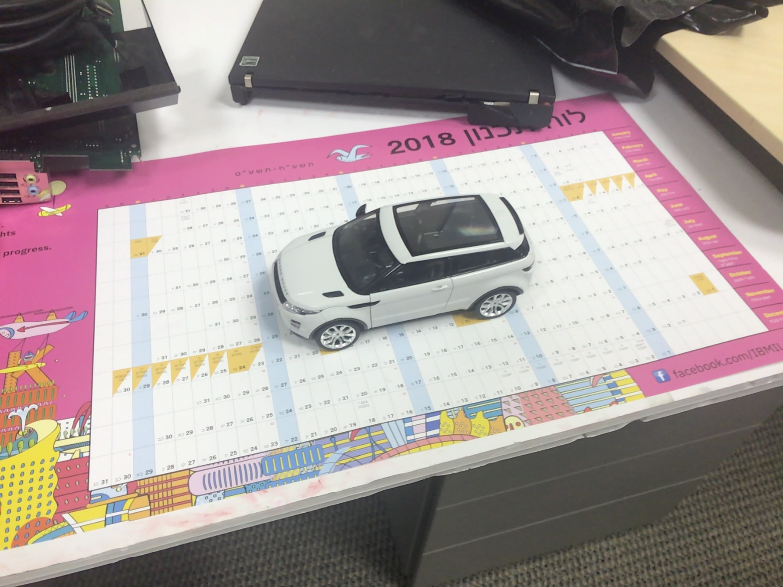
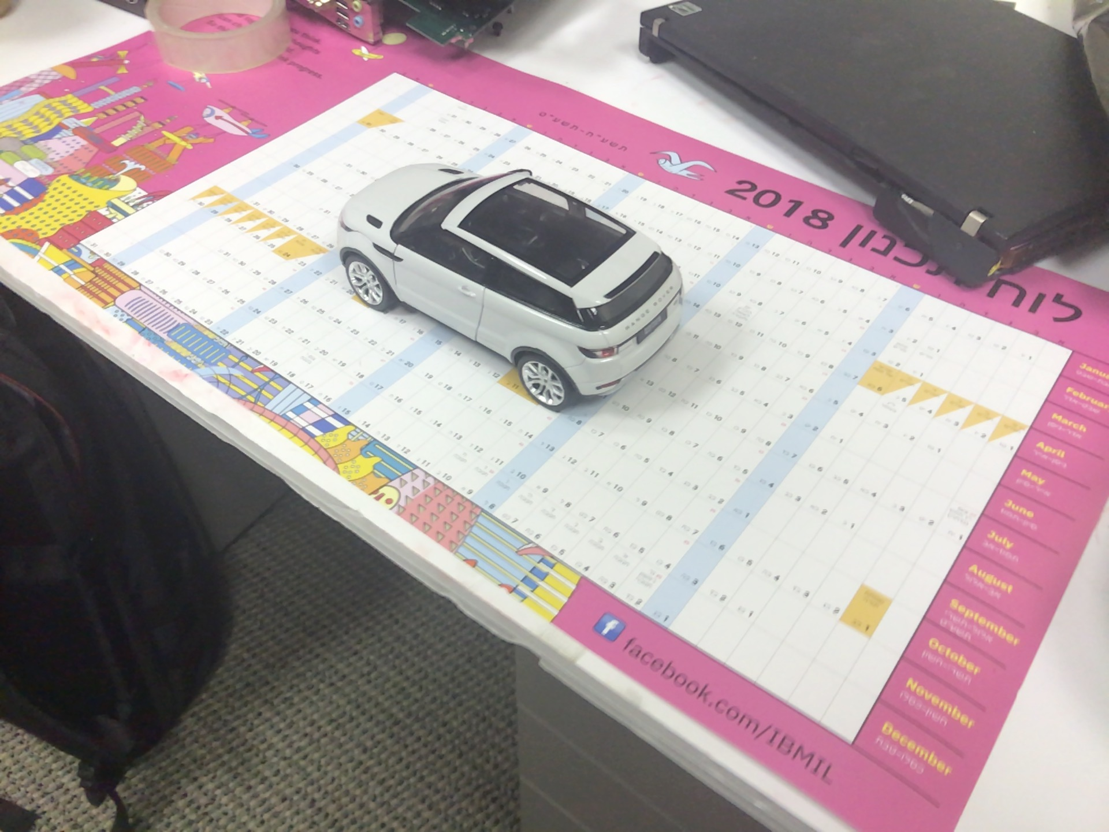
Some pictures from the process and explanations behind it
some frames from one of the scans:

Slide 6
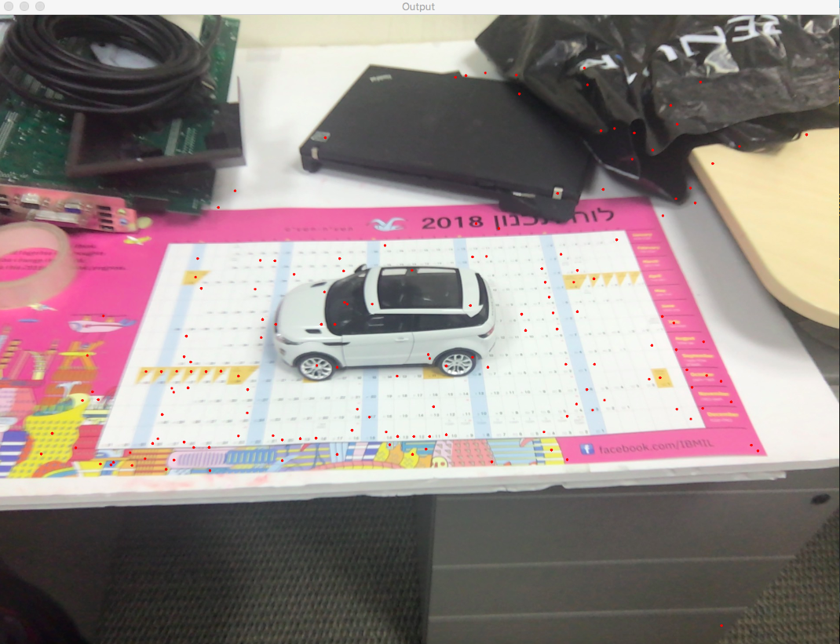
Projection of features on an image.
Math behind projection of a 3D point in the world (Pw) to a 2D picture:
Pc = (R * Pw) + T (Pc = point in camera).
Pd = Pc_z (Pd = distance from camera)
Pn = Pc / Pd (Pn = projected normalized coordinates)
Pi = K*Pn, where K is the camera intrinsic parameters: [fx 0 cx 0 fy cy 0 0 1]

Slide 7
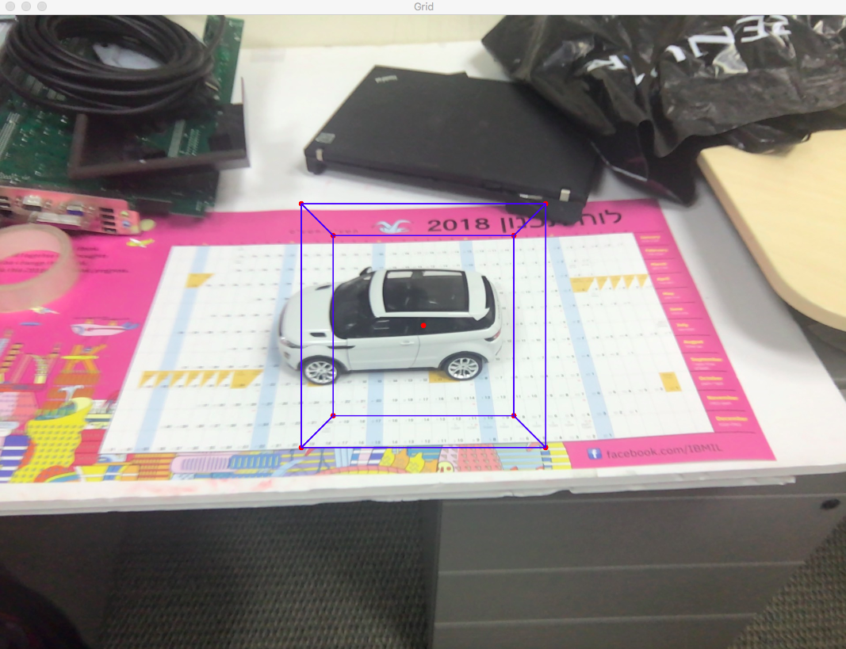
creating the grid and project it to the image, project its center as well
We defined a grid’s axis by one of the frame’s axis.
We calculated its center as an average of all of the features locations, there for its should contain most of the features from the scan.

Slide 8
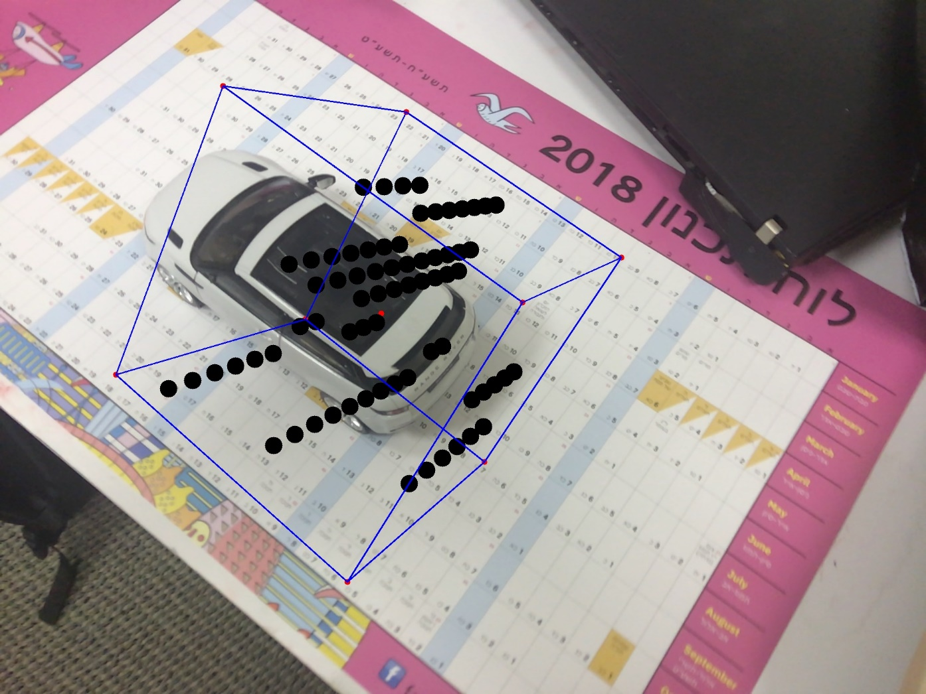
Ray casting example on the grid, projected to the image
Each ray is defined by using the frame’s camera position
And a feature.
Ray equation : P0 + S * V.
P0 - is the camera position,
V - the direction vector from the camera position to the feature
S is the amount of steps we need to take in V direction,
in order To reach to each point on the ray,
therefore each voxel Will have a unique S, we denote it as
S_voxel.

Slide 9
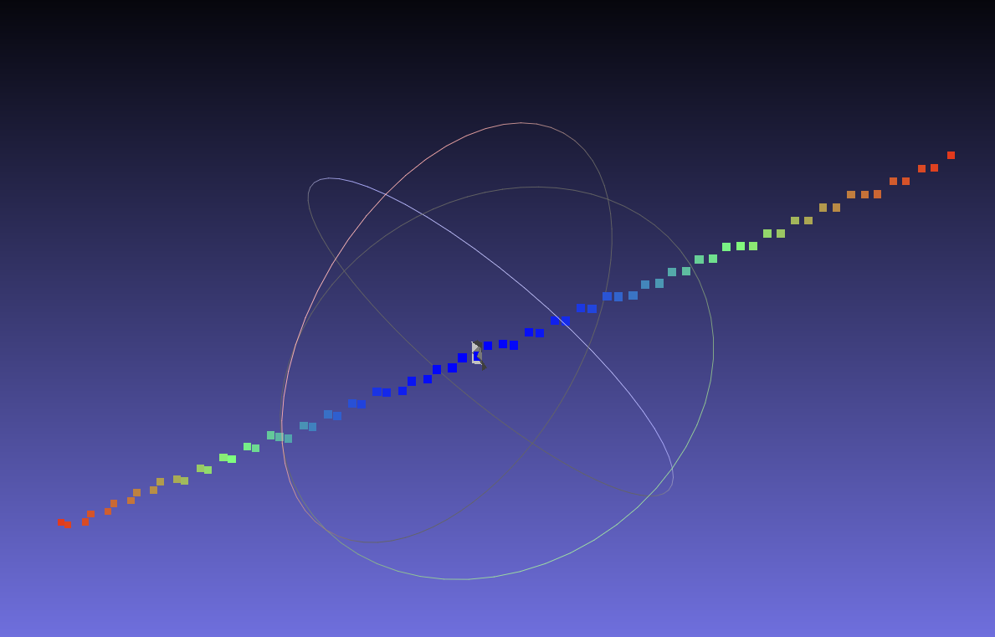
Ray casting w.r.t voxel’s confidence (blue = higher confidence, red = lower confidence), presented in meshlab
Math behind calculation of voxel’s confidence:
If the voxel’s hasn’t been initialized yet, its confidence would be :
exp(-pow(s_voxel - 1, 2) / (SIGMA * SIGMA)));
This function is always between [0,1], therefore voxel cannot have negative confidence.
where SIGMA is the parameter that determines how quickly voxel’s confidence will converge to zero w.r.t its distance (s_voxel) from the feature that created the ray, therefore it has a crucial role on our model.
If the voxel already has confidence we sum its old confidence to the expression denoted above.
Therefore we will have more confidence in voxels which have been updated by many rays.

Slide 10
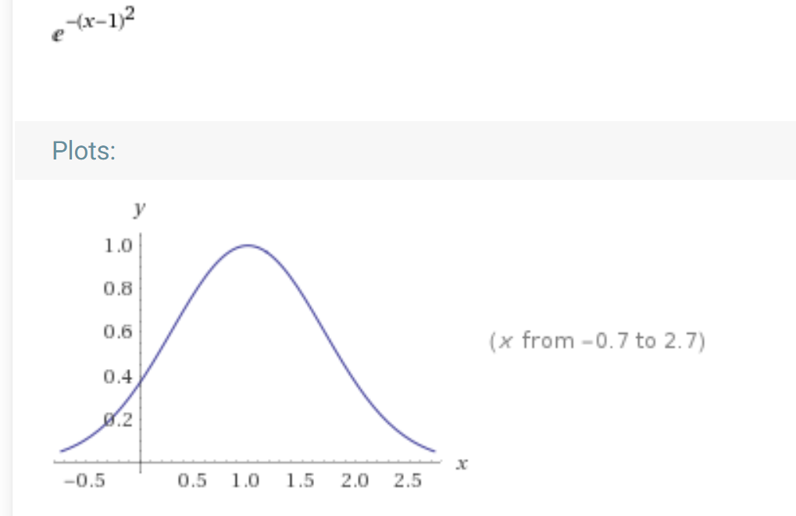
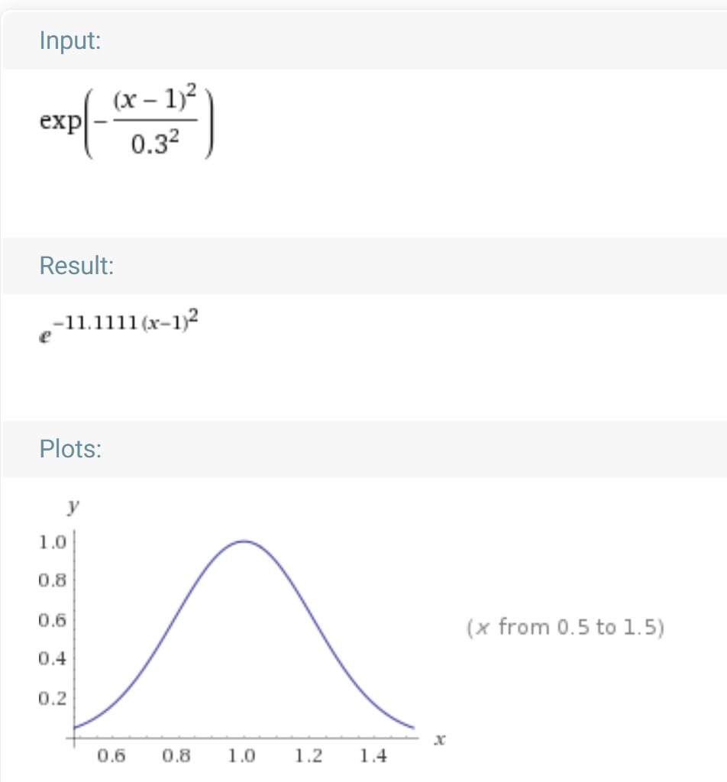
Confidence convergence to zero w.r.t SIGMA
The lower SIGMA is, the faster voxel’s confidence converge to zero, w.r.t its distance from the feature.
Which means only voxels that are close to any feature will have a meaning to us.

Slide 11
Distance calculation
The distance parameter denotes a voxel’s distance from a feature, therefore voxels that a holds a feature within them, will initially have zero as their distance.
distance calculation :
if voxel dosent have distance yet its distance would be:
distance = tanh(ALPHA * (s_voxel - 1));
if a voxel has already a distance, its new distance would be:
(vox.oldDistance)* (vox.oldConfidence ) + tanh(ALPHA * (s_voxel - 1)) * exp(-pow(s_voxel - 1, 2) / (SIGMA * SIGMA))))
/ (vox.oldConfidence + exp(-pow(s_voxel - 1, 2) / (SIGMA * SIGMA)))));
Which means a voxel’s distance is a weighted average of its S_voxel and its confidence.
Explanation regarding tanh(ALPHA * (s_voxel - s_point)) is on the next slide/

Slide 12
tanh(ALPHA * (s_voxel - 1));
Tanh’s range is [-1, 1] , there for voxels that are located on the part of the ray that is before the given feature, will have negative distance
w.r.t to the given feature.
Voxels that are located on the part of the ray that is after the given feature, will have positive distance w.r.t the given feature.
ALPHA parameter determines how fast the tanh function will converge to 1 & -1 respectively , therefore determines if voxels that are close to the feature will have higher or lower distance values respectively.

Slide 13
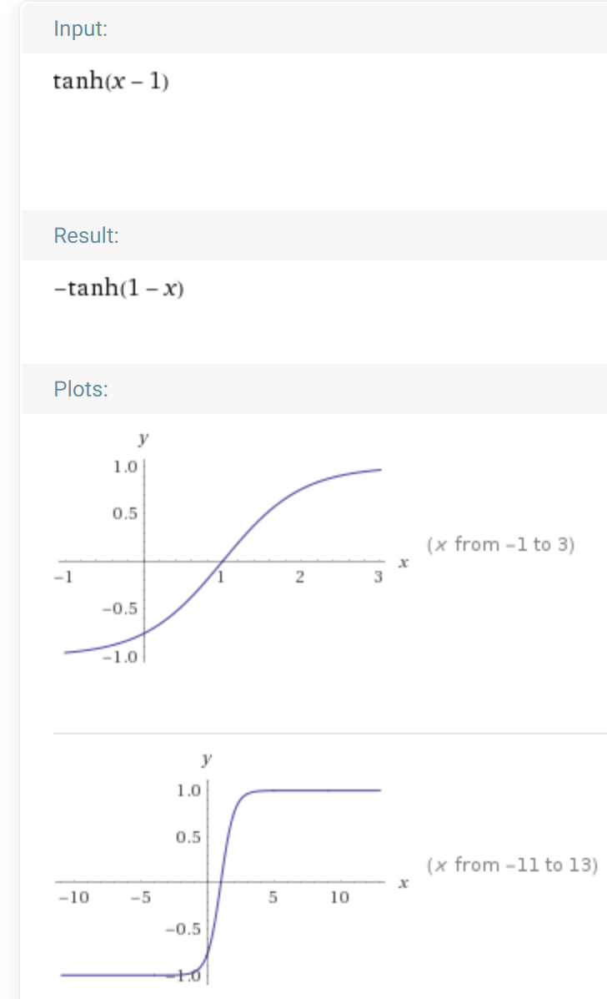
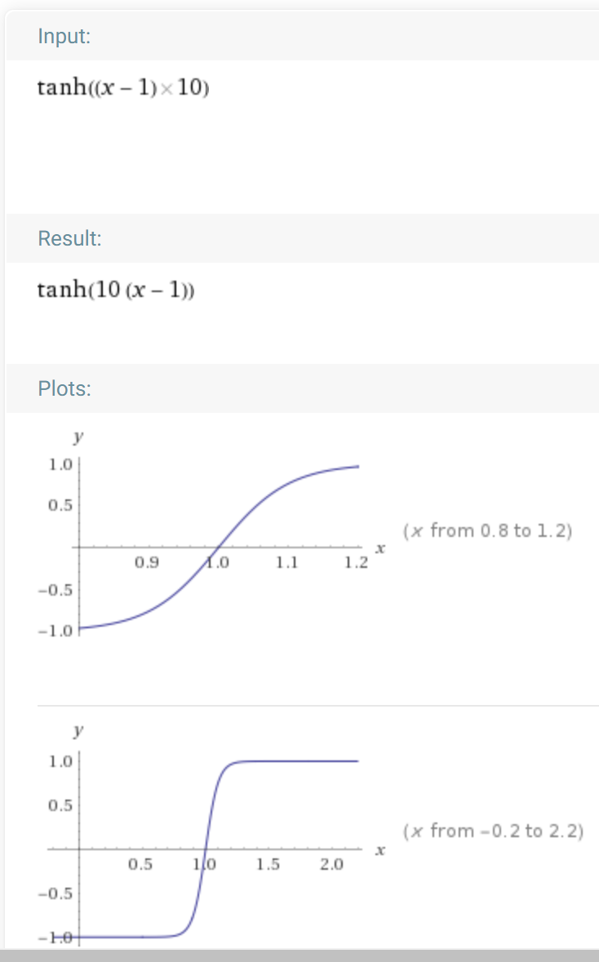
Distance convergence w.r.t ALPHA
The higher the ALPHA is the faster the function converge to 1 and -1 respectively.

Slide 14
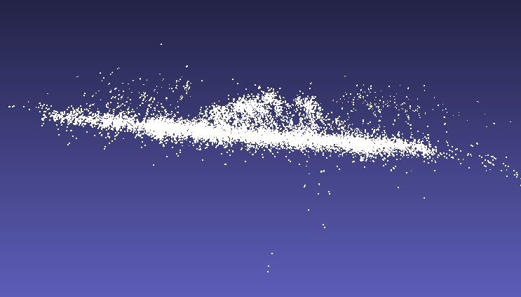
Arkit features from our jeep scan presented in mashlab as .ply file

Slide 15
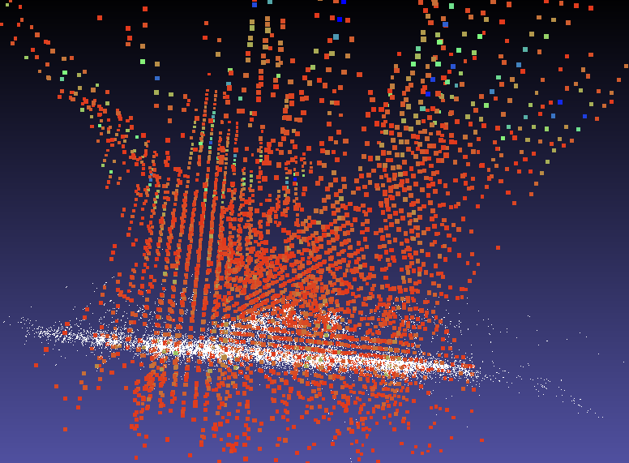
Arkit features together with our grid w.r.t voxel’s confidence, first version (not accurate one).

Slide 16
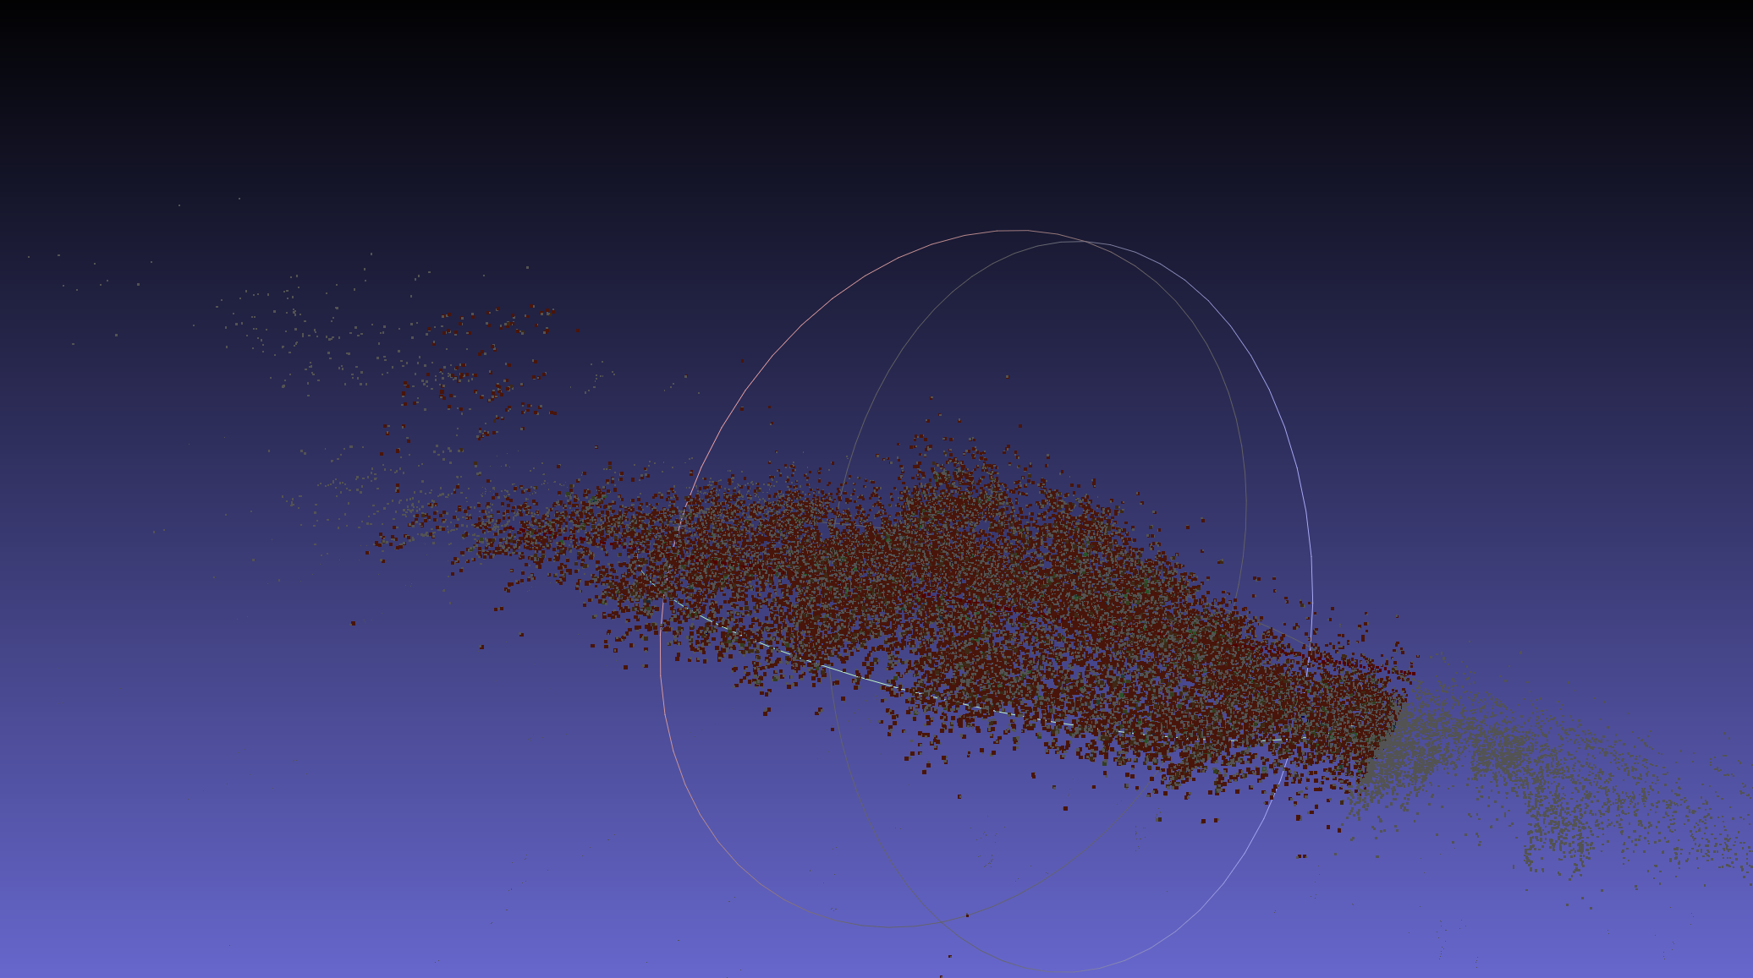
ArKit features with our grid w.r.t confidence, more accurate version

Slide 17
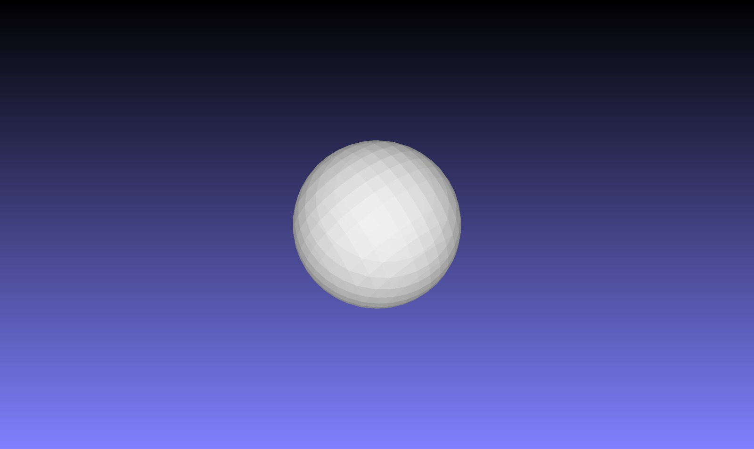
First step of using marching cubes algorithim was to create a mesh of a ball, which is easier to verify correctness.

Slide 18
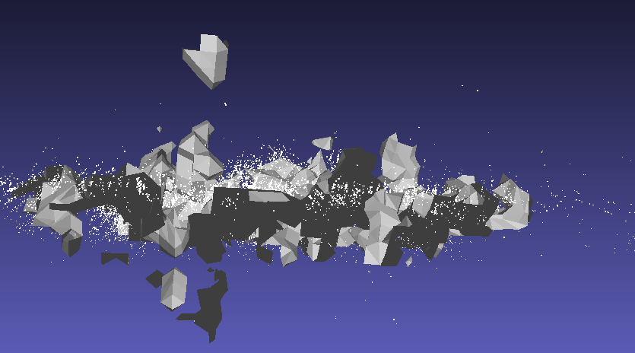
First attempt to create a mesh from our jeep scan, obviously not a correct one.

Slide 19
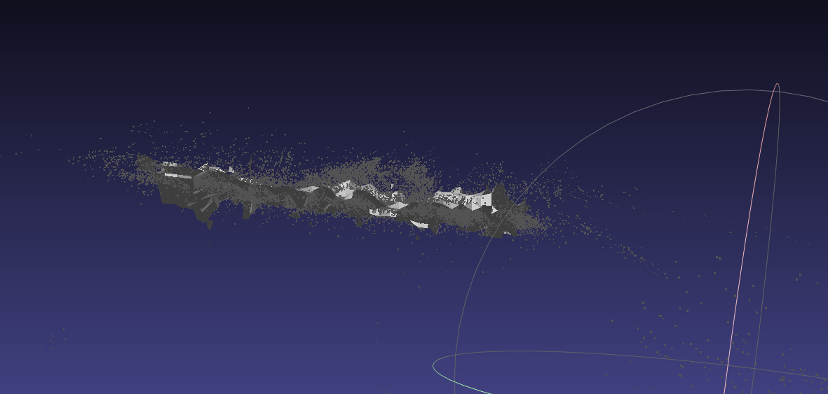
Anoter attempt to create a mesh, still not accurate (features are in gray)

Slide 20
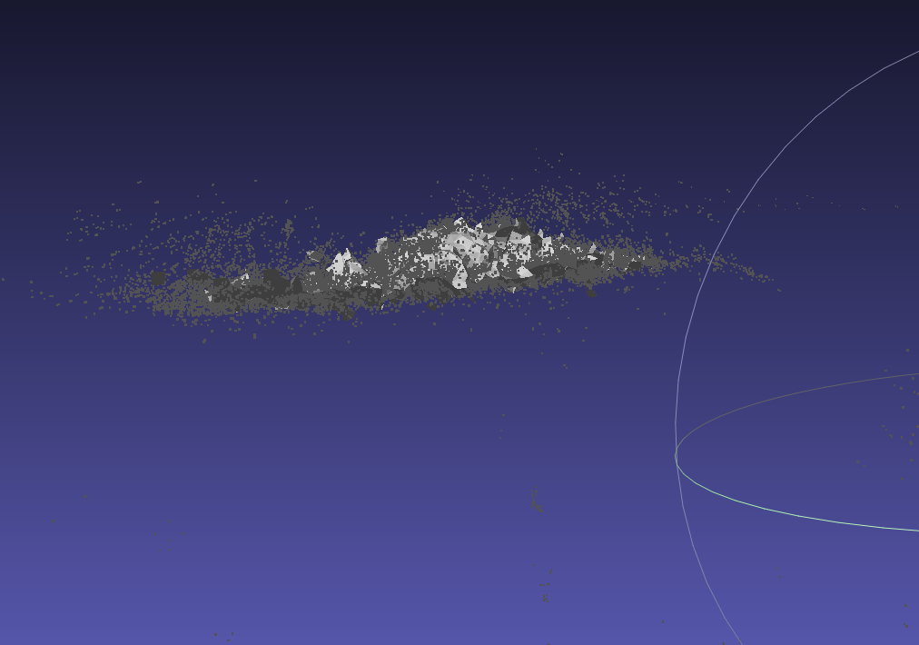
A more accurate mesh, still not enough

Slide 21
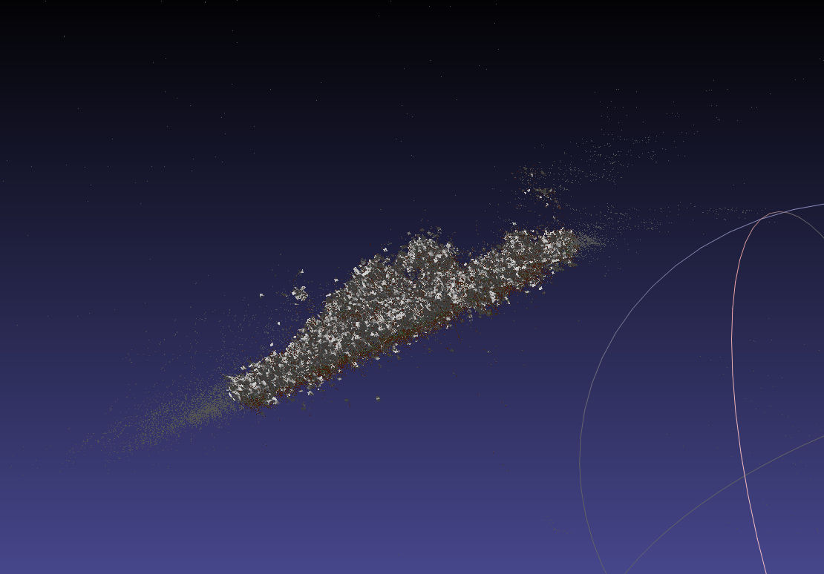
After debugging, changing the grid size, ALPHA, SIGMA, and each voxel size we could manage to get a better results

Slide 22
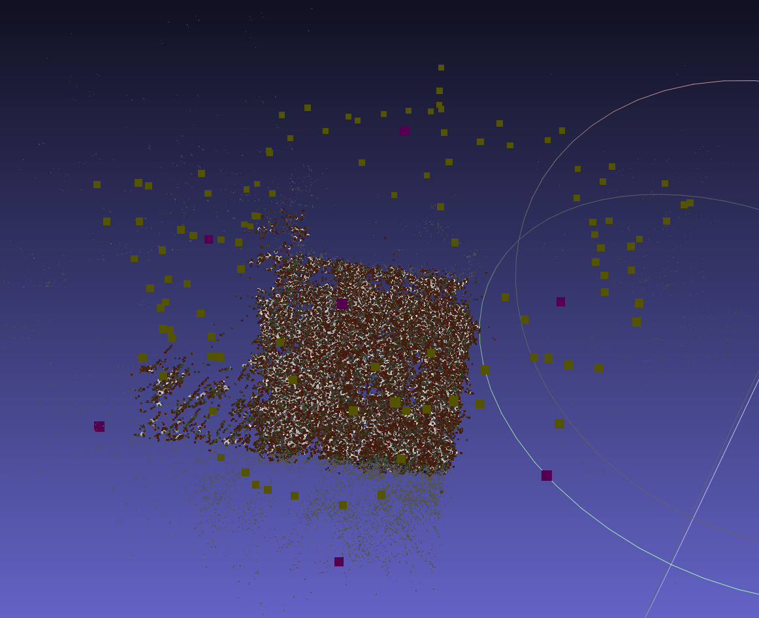
Mesh, grid w.r.t confidence, grid boundaries (in pink), and the camera positions (in yellow)

Slide 23
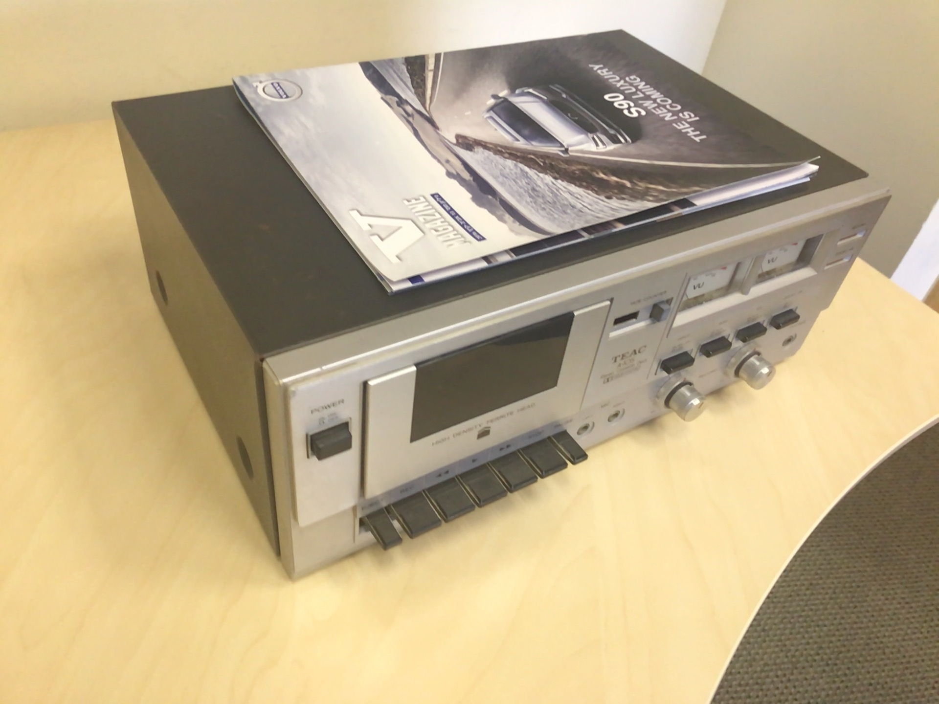
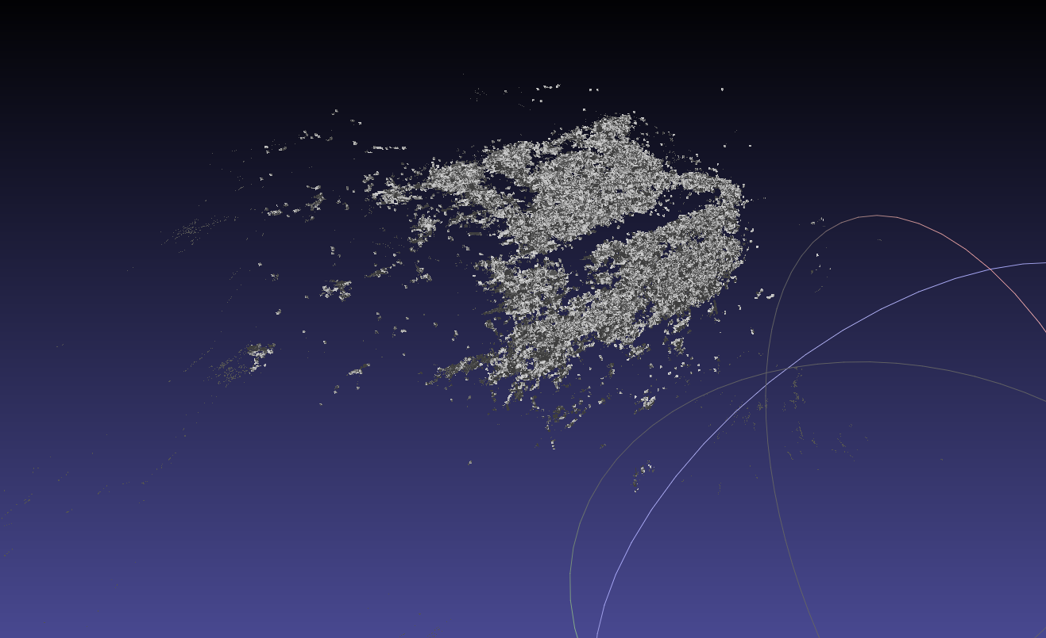
Meshs from diffrent scans

Slide 24
Where we can go next?
1. Densify Arkit data with densification algorithims such as searching feature along epipolar line.
2. develop real – time mobile application for scanning and creating the 3D model.
3. create a mesh “on the fly”, other than create complete scan and then create a mesh out of it.

Slide 25
The End

